Slide 1
Accessible Web Platforms for displaying HTML on consumer and IoT devices
March 14, 2019

Slide 2

Adina Halter
Sr. Product Manager & Technology Lead, Accessibility
Comcast NBCUniversal
Twitter: @haltersweb
GitHub: haltersweb.github.io/Accessibility/
Ramasamy Thalavay Pillai
Principal Engineer
Comcast NBCUniversal
GitHub: https://github.com/ramasat/
LinkedIn: https://www.linkedin.com/in/ramasamythalavaypillai/

Slide 3
Xfinity X1 platform
Cloud-based platform
Television set-top box
Second-screen experience
Set-top box controls home
Over-the-top (OTT)-type applications
YouTube*
Amazon Prime*
Netflix
* HTML5 application
Notes:
Open source and available for anyone to use the work we have done,
It’s the X1 OTT feature which brings us here to discuss the work we had to do to deliver accessibility to these HTML5 applications such as YouTube, Amazon, Pandora, etc.

Slide 4

A11y and Web Applications
Bicycle Wheel. Anonymous. CC

Slide 5
Typical Model
Application / Browser
Assistive Technology
Voice Engine
Accessibility API
Voice
API

Slide 6
Typical Model: application / browser
Application / Browser
Assistive Technology
Voice Engine
Accessibility API
Voice
API
Application (usually containing a user Interface) that offers a11y support
Notes:
Application / Browser: The application that wants to provide the accessibility support to its user. As far as "web accessibility" is concerned, these are nothing but the web applications and web browsers (ex., Web Apps in Chrome, Edge, Safari etc.)

Slide 7
Typical Model: assistive technology (AT)
Assistive Technology
Application / Browser
Voice Engine
Accessibility API
Voice
API
Tool used by people with disabilities to interact with application
Notes:
Assistive Technology (AT): The term "assistive technology" is broader in nature, and refers to the tools used by people with disabilities to accomplish certain tasks. From "web accessibility" perspective, this could mean Screen readers, Speech input software, Text readers, Screen magnification software, Alternative input devices, etc. Some of the existing ATs include:
JAWS for Windows, NVDA, or Voiceover for Mac, ORCA for Linux.

Slide 8
Typical Model: a11y application program interface (API)
Application / Browser
Assistive Technology
Voice Engine
Accessibility API
Voice
API
Provides accessible representation and allows AT to access application contents
Notes:
Accessibility APIs: These are a set of application program interfaces (APIs) provided by the platform owners (who integrate different GUI applications and browsers into their platform) to the AT for accessing the display contents without having to maintain an off-screen model. This interface helps the AT to provide an alternative and accessible representations of what is being displayed on the screen to the user via a voice read out. Some of the accessibility APIs developed for different platforms include:
Microsoft Active Accessibility (MSAA), IAccessible2, User Interface Automation (UIA), Linux Accessibility Toolkit (ATK) and Assistive Technology - Service Provider Interface (AT-SPI), Mac OS X Accessibility Protocol

Slide 9
Typical Model: voice engine
Voice Engine
Application / Browser
Assistive Technology
Accessibility API
Voice
API
Text-to-speech (TTS) utility used by ATs to voice out content. (sometimes w/in AT)
Notes:
Voice Engine: This is a locally available or cloud based text to speech utility or framework that will be used by the ATs to actually voice out the screen content. In some cases, AT itself plays the role of Voice engine as well.

Slide 10
Accessibility Architecture in GTK+ Platforms
GTK+ Applications
Accessibility Tool Kit (ATK)
exposes an accessible representation of toolkit’s objects
exposes appropriate application interface & content
GTK+ Accessibility Implementation
ATK / AT-SPI Bridge
AT-SPI (Over DBus)
AT Layer (AT and TTS software)
Notes:
Gnome Tool Kit
ATK: Accessibility Tool Kit. Used by GTK+ Applications to expose accessible representation of the toolkit's objects, along with appropriate interface on the side of the applications exposing the content.

Slide 11
Accessibility Architecture in GTK+ Platforms
GTK+ Applications
GTK+ Accessibility Implementation
ATK/AT-SPI Bridge
creates mapping between ATK and AT-SPI (assistive technology service provider interface)
uses DBus IPC (inter-process communication) mechanism to interact with AT-SPI
ATK / AT-SPI Bridge
AT-SPI (Over DBus)
AT Layer (AT and TTS software)
Notes:
ATK/AT-SPI Bridge: The glue layer that creates mapping between ATK and AT-SPI (Assistive Technology Service Provider Interface) library over DBus.

Slide 12
Accessibility Architecture in GTK+ Platforms
GTK+ Applications
GTK+ Accessibility Implementation
ATK / AT-SPI Bridge
AT-SPI Library
assistive technology service provider interface
used by ATs to inspect and interact w/ application
AT-SPI (Over DBus)
AT Layer (AT and TTS software)
Notes:
AT-SPI Lib: Assistive Technology Service Provider Interface - The interface that the assistive technologies understand and use to inspect and interact with the applications.

Slide 13
Accessibility Architecture in GTK+ Platforms
GTK+ Applications
GTK+ Accessibility Implementation
ATK / AT-SPI Bridge
AT-SPI (Over DBus)
AT (assistive technology)
Often includes the TTS (text-to-speech) engine within the AT itself.
AT Layer (AT and TTS software)
Notes:
AT: Assistive Technology. Example includes ORCA Screen Reader.

Slide 14
WPE, WebKit, & RDK
WebKit
One of the most used open source web engines
WPE
web platform for embedded
WPE WebKit
WebKit port for embedded and low-consumption computer devices
Notes:
Webkit: One of the most used Open Source WebEngine.
WPE Webkit: Web Platform for Embedded WebKit is a reference WebKit port for embedded and low-consumption computer devices.
Other ports of WebKit: iOS and Mac (Safari), GTK+ (WebKitGTK+), Qt (QtWebkit), EFL, etc.

Slide 15
WPE, WebKit, & RDK
RDK (reference design kit)
Originated in the cable industry
Open source, pre-integrated software platform
Cloud-based
Powers customer-premises equipment (CPE) such as:
set-top boxes
broadband gateways
converged devices
Notes:
RDK: The Reference Design Kit (RDK) is an open sourced, pre-integrated, software platform that powers customer-premises equipment (CPE) from Cable TV service providers, including set-top boxes, broadband gateways, and converged devices.

Slide 16
WPE, WebKit, & RDK
RDK / WPE integration
Pre-integrates WebKit as its web engine
Allows TV service providers to deploy HTML apps on their set-top boxes
i.e. YouTube and Amazon Prime on Comcast’s X1 set-top box
Notes:
All of this is open source and available, including the work we did to make the embedded browser accessible.
RDK pre-integrates WPE WebKit as its web engine that allows the TV service providers to deploy many HTML Apps (such as YouTube, Amazon Prime etc..) in their Set Top Boxes. (For ex: Comcast’s X1 STBs).

Slide 17
WPE accessibility support on RDK
WPE port of WebKit does not support a11y, although a11y framework was included
We added a11y support to our RDK version of the WPE WebKit port
Created our own custom AT which parses HTML applications in unique ways
Notes:
The GTK port of WebKit supports accessibility using ATK & AT SPI Interface. The Assistive Technology comes from the device where it runs.
But the WPE WebKit port (which is used in RDK) did not support accessibility, even though the basic framework exists.
Comcast has recently added support for accessibility in the WPE port of WebKit and connected it with its home grown Assistive Technology.
With this, RDK now provides fully functional assistive technology (voice guidance) to the user who uses any HTML apps (ex., You Tube, Amazon Prime) in the RDK devices (such as X1 STBs).
How did we do this?

Slide 18
How RDK supports a11y
Application / Browser
Assistive Technology
Voice Engine
Accessibility API
Voice
API

Slide 19
How RDK supports a11y
Application / Browser
Assistive Technology
Voice Engine
App / Browser: RDK Browser + WPE WebKit
Accessibility API: ATSPI
Assistive Technology: RDK Assistive Technology
Voice Engine: TTS Engine
A11y
API
Voice
API
Web Browser
ATSPI IPC Interface
A11y Framework Process
IPC Interface
TTS Engine Process
UI Process
RDK
Assistive
Technology
Voice / TTS Engine
RDK Browser 2
Web View (WPE)
ATK
ATK <-> AT SPI
Voice APIs
Web Process
A11y
APIs
Web Core
Platform Porting Layer
ATSPI Lib
GStreamer
ATK
ATK <-> AT SPI
Notes:
Note: Talk about the distinction between what happens in the cloud and what happens in the device.
ATSPI: Assistive Technology Service Provider Interface
IPC: Inter Process Communication
ATSPI: = HTML-based Accessibility Tree + Browser Chrome Accessibility Tree
Gstreamer: allows you to build any media pipeline. We give voice file to it and it plays out this media.

Slide 20
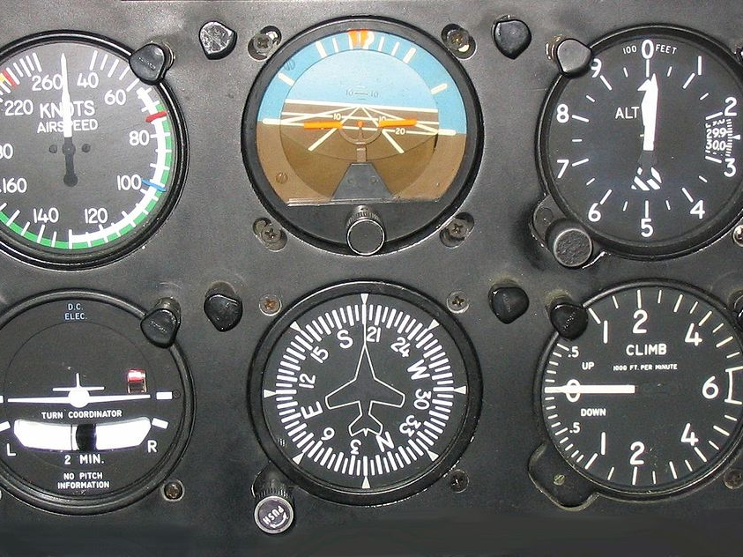
HTML to TTS
Six Flight Instruments. Meggar. CC BY-SA
Notes:
[Remember to poll the audience for engineers vs prod owners]

Slide 21
Challenges
X1 originally Java-based platform
No native AT component
High performant, lean browser interface
D-pad control constraints
Unique voice-out requirements
Notes:
Originally Java-based platform which passed strings to TTS engine. So we were cutting a new path with introducing HTML-based TTS
No native Assistive technology component. So in creating one we had to define the rules for understanding and speaking out HTML.
AT ← → ACCESSIBIITY API ← → BROWSER
High performant, lean browser interface:
D-pad control (up, down, right, left) constraints. Focus-based. No browse mode
Unique voice-out requirements: i.e. h1 announce on screen load, subheadings announcing one time on entering content, grid views and tables not announcing column number, row number, or role.

Slide 22
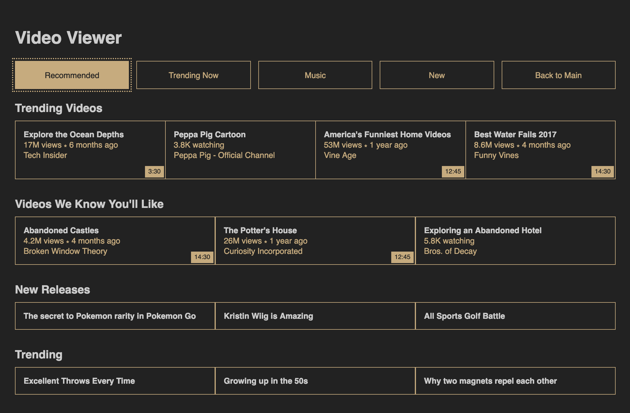
Paradigms
Heading
Button
Table
Sub-heading
Grid
Cell
Notes:
Describe what text is in these elements

Slide 23
Paradigms: NVDA
”Heading level 1. Video viewer.”
“Navigation landmark button. Recommended.”
“Table with 1 row and 4 columns. Trending videos.”
“America’s funniest… Row 1. Column 2.”
“Out of table. Table. Heading level 3. Videos we know you’ll like.”
“New releases row. The secret to Pokemon…”

Slide 24
Paradigms: X1
”Video viewer. Recommended button.”
“Trending now button.”
“Trending videos. Explore the ocean depths…”
“Peppa Pig cartoon. 3.8K watching…”
“Videos we know you’ll like. Abandoned castles. 14 minutes 30 seconds…”
Notes:
Generally focus-based
Page contents are not read automatically
Heading announced on load
Default action item announced on load
Grid row/column counts/numbers are not announced
Subheadings announced whenever sub-section is entered

Slide 25
Demo
@haltersweb
Notes:
Key was to understand HTML to ARIA translation in order to understand the accessibility API output
The issue with embedded devices is that screen readers don’t run on these devices, High performance, low power devices. Try to mirror the screen reader with the constraints and requirements of our system.

Slide 26
HTML to ARIA translation
@haltersweb
Notes:
Key was to understand HTML to ARIA translation in order to understand the accessibility API output
The issue with embedded devices is that screen readers don’t run on these devices, High performance, low power devices. Try to mirror the screen reader with the constraints and requirements of our system.

Slide 27
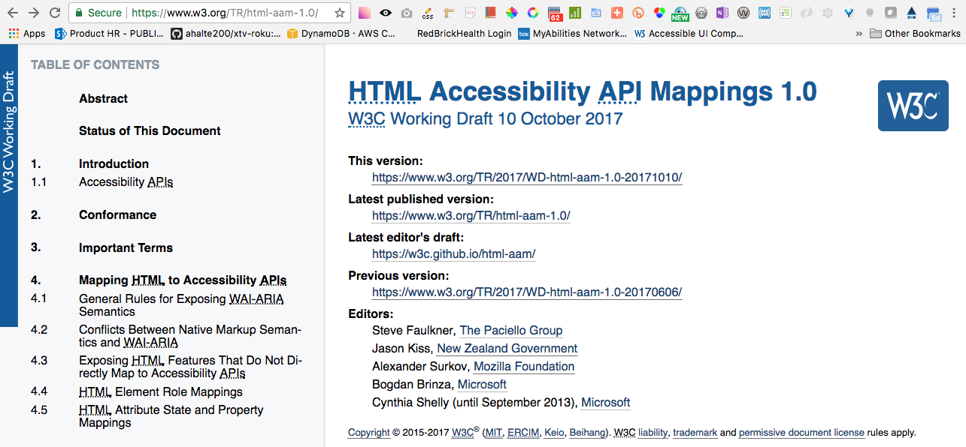
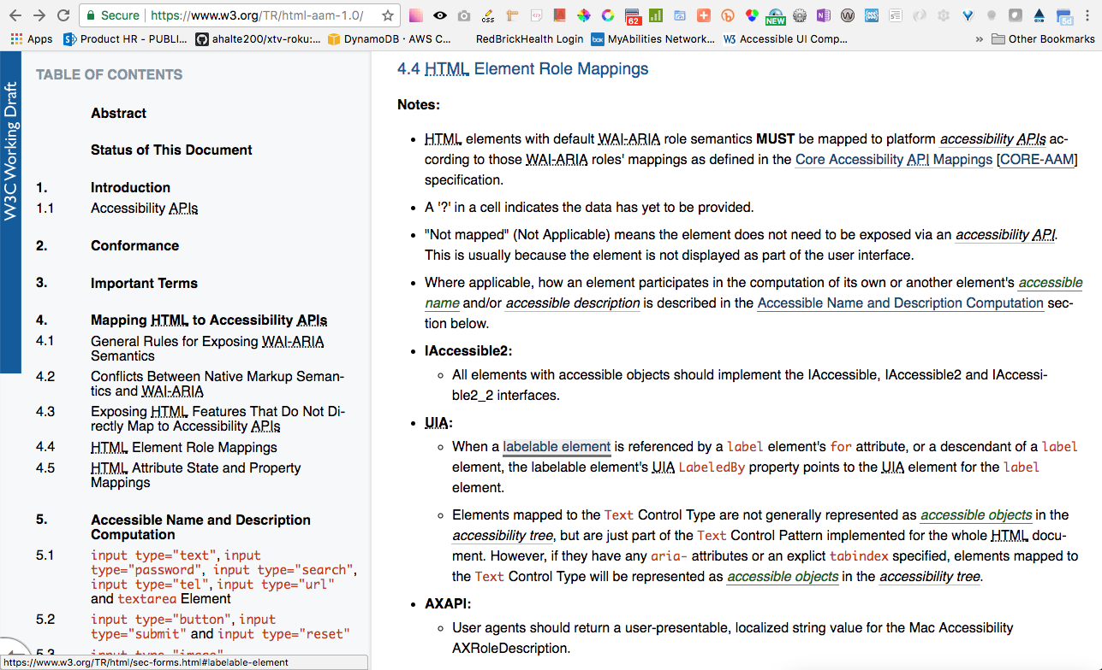
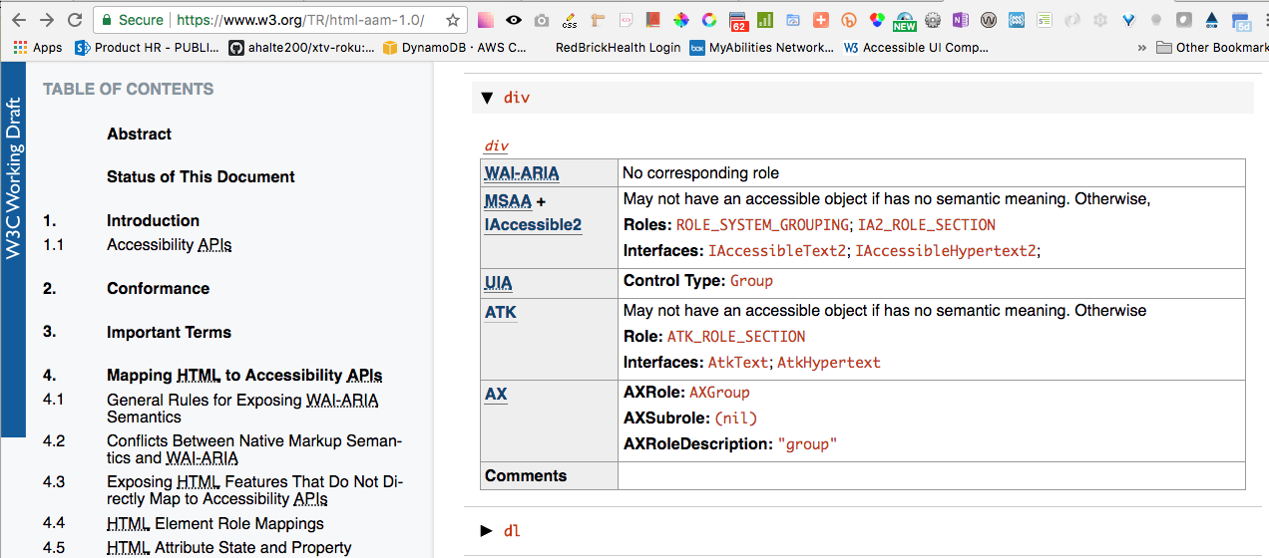
HTML Accessibility API Mappings
@haltersweb
Notes:
https://www.w3.org/TR/html-aam-1.0/
HTML Accessibility API Mappings (HTML-AAM) defines how user agents map HTML 5.2 [HTML52] elements and attributes to platform accessibility application programming interfaces (APIs)

Slide 28
Button & link API mappings*
element | WAI-ARIA role | ATK role | properties | states
button | button | use WAI-ARIA | title aria-hidden
link (a[href]) | none | not mapped | title aria-hidden
* not an exhaustive mapping

Slide 29
Button: native
HTML:
<button>Submit</button>
Role:
button
Properties/States:
title: “Submit”
Text Output:
“Submit. Button.”

Slide 30
Button: ARIA
HTML:
<div role=“button”>Submit</div>
Role:
button
Properties/States:
title: “Submit”
Text Output:
“Submit. Button.”

Slide 31
Button: native + attributes
HTML:
<button disabled aria-label=“Submit”></button>
Role:
button
Properties/States:
title: “Submit”
aria-disabled: “true”
Text Output:
“Submit. Button. Disabled.”

Slide 32
Heading API mappings*
element | WAI-ARIA role | ATK role | properties | states
h1, … h6 | heading with aria-level property set to the # of the element tag | use WAI-ARIA | title aria-level aria-hidden
caption | none | ATK_ROLE_CAPTION | title aria-hidden
* not an exhaustive mapping

Slide 33
Page heading (h1)
HTML:
<h1>Guide</h1>
<div role=“heading” aria-level=“1”>Guide</div>
Role:
heading (+ aria-level=“1”)
Properties/States:
title: “Guide”
aria-level: 1
Text Output:
“Guide”

Slide 34
Section heading
HTML:
<h2>Guide</h2>
<div role=“heading” aria-level=“3”>Guide</div>
<caption>Guide</caption>
Role:
heading (+ aria-level)
ATK_ROLE_CAPTION
Properties/States:
title: “Guide”
aria-level: 2-6 (none for caption)
Text Output:
“Guide”

Slide 35
Table headings
Sunday Night Shows <caption>
Blues Clues. | Drake and Josh. | iCarly.
<table>
Monday Night Shows h2#table1Title
table aria-labelledby=table1Title
<table>
Happy Days. | The Brady Bunch. | The Odd Couple.
Tuesday Night Shows h2
table aria-label=“Tuesday Night Shows”
<table>
Teletubbies. | Between the Lions. | Sesame Street.
Wednesday Night Shows h2
<table>
I Love Lucy. | The Honeymooners. | My Mother the Car.

Slide 36
Grid headings
Monday Night Shows h2#row1Title
role=row aria-labelledby=row1Title
Happy Days. | The Brady Bunch. | The Odd Couple.
Tuesday Night Shows h2
role=row aria-label=“Tuesday Night Shows”
Teletubbies. | Between the Lions. | Sesame Street.
Wednesday Night Shows h2
role=row
I Love Lucy. | The Honeymooners. | My Mother the Car.

Slide 37
X1 logic for subheadings
@haltersweb
Notes:
Key was to understand HTML to ARIA translation in order to understand the accessibility API output

Slide 38
1. build node array
Search DOM for the focused element plus all subheadings* on the page
[
]
h5
h3
:focus
h3
role=“heading”
caption
h6
* H levels 2-6, role=“heading” & aria-level 2-6, caption

Slide 39
2. find current index
Identify the index of the focused element in the node array
[
]
h5
h3
:focus
h3
role=“heading”
caption
h6
i = 2

Slide 40
3. check for no subheading
If the index of the current element is 0 it has no heading
[
]
:focus
h5
h3
h3
role=“heading”
caption
h6
i = 0

Slide 41
4. find correct subheading
The correct subheading will be the element just before the focused element in the node array
[
]
h5
h3
:focus
h3
role=“heading”
caption
h6
i = i – 1

Slide 42
5. don’t voice same subheading
Save previous subheading in a var. Then match it to current subheading. If equal then don’t speak subheading.
h3
var priorSubheading =
[
]
h5
h3
:focus
h3
role=“heading”
caption
h6
=
priorSubheading

